Slide 1
Trash Management System Using AI
Prepared by: Mohamad Kassem & Khadija Jaffal
In the context of the course: Research & Innovation
Supervisors: Prof. Pierre Maret, Prof. Olivier Boissier & Prof. Fabrice Muhlenbach.
CPS2 Master1 - Academic Year 2020-2021

Slide 2
Outline:
Research Area
Keywords
Project Importance
Facts & Statistics
State of the art
Targeted Technique
Ethics
Partnership
References

Slide 3
Research Area:
Trash sorting and management in the factory using Artificial intelligent techniques.

Slide 4
Keywords:
Trash
Pollution
Bin
Sorting
Management
Sensors
Camera
AI
Robots
IoT
Arduino
Raspberry Pi
Deep Learning

Slide 5
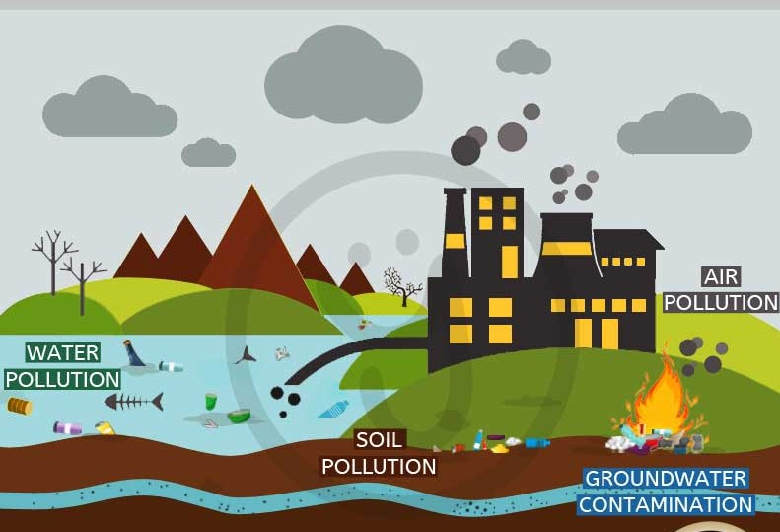
Project Importance
Different Kinds of Pollution Caused by the inconvenient treatment of trash:
Water Pollution
Soil Pollution
Air Pollution
Ground-Water Contamination
Solution: Trash Sorting & Management

Slide 6
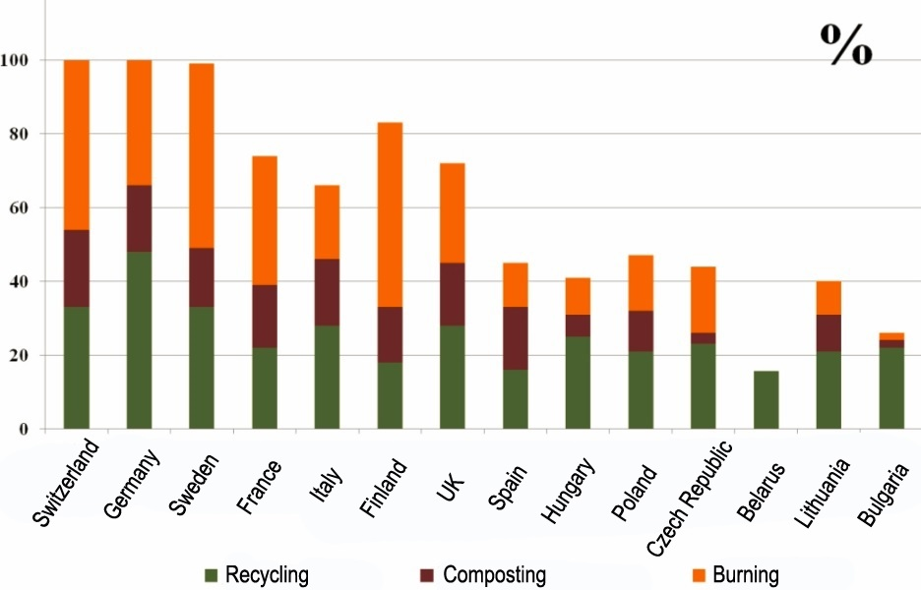
Facts & Statistics
The Problem of plastic wastes in France.
Even Germany has recycling problems because of the weak sorting process.
Sorting trash using human employees is dangerous for their health.

Slide 7
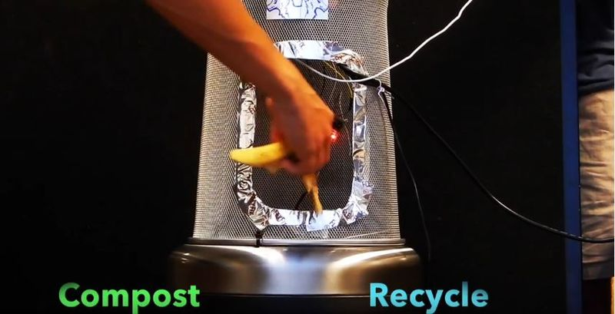
Auto-Trash
Smart Trash Can that Automatically Sorts Waste by Type.
Uses Raspberry Pi module equipped with a camera.
Uses image recognition.
Rotating top to sort.

Slide 8
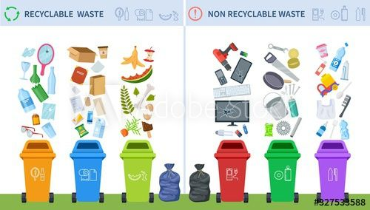
Classification of Trash for Recyclability Status
Computer Vision: SVM and CNN models.
6 different classes.
Dataset: 400-500 images for each category.
Best Accuracy: 63%

Slide 9
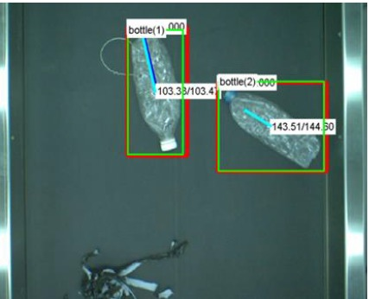
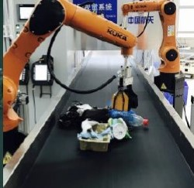
Robotic Grasping System Using Deep Learning
Deep learning models: RPN and VGG-16.
Target: plastic bottles only.
Object detection.

Slide 10

IoT Based Garbage Management System
System responsible for the management of garbage into dry & wet.
The system will notify the responsible person in 3 different cases:
- Mixing dry & wet garbage. (Moisture)
- Bin level. (Ultrasonic sensors)
- Fire Detection. (Flame sensors)
Raspberry Pi, Arduino UNO and different types of sensors are used.

Slide 11
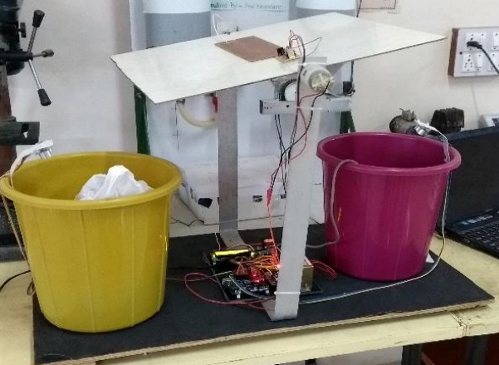
IOT Based Garbage Monitoring & Sorting System
Sorting into wet & dry at home.
System Main functionalities:
1- Sorting:
- Drop the object in suitable bin.
- Display the result on screen.
- Save the result in database.
2- Checking bin level.
Used components: Arduino, DC Power , sensors, motor driver, LCD, Wi-Fi.

Slide 12
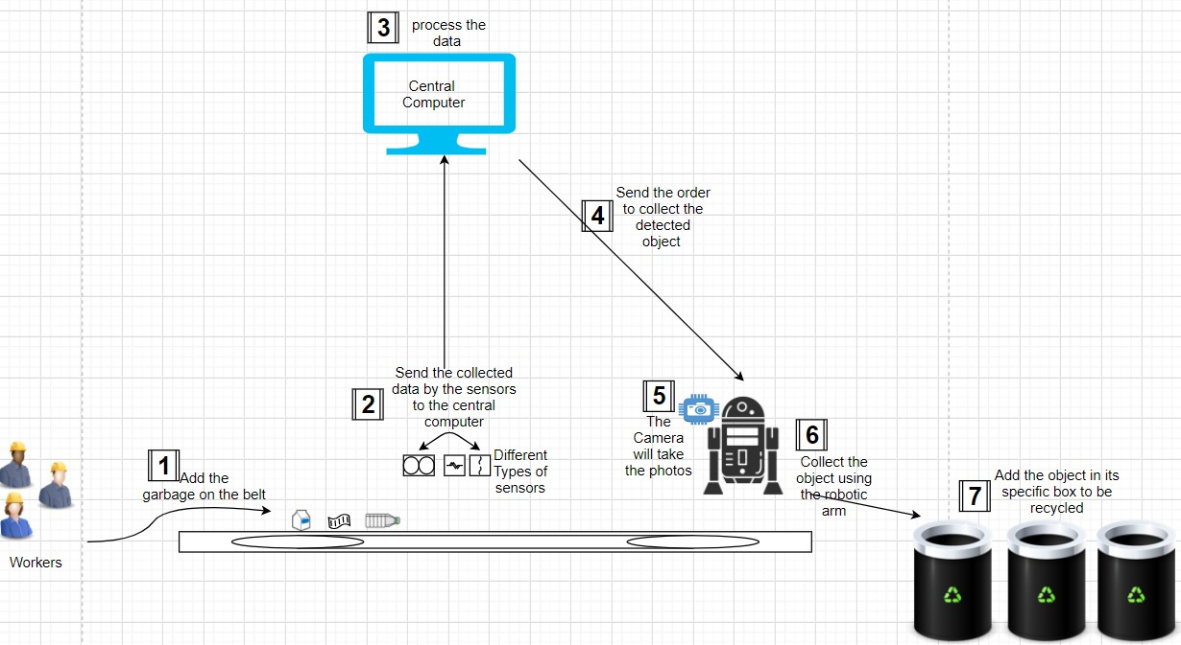
Targeted Technique
The sorting process takes place in the factory. So first move trash to the factory. Then start the following steps:
Put trash on moving belt.
Several types of sensors used.
Central computer.
Central computer & Robotic arm.
Type of Arms.
Detection using Camera.
Drop objects in suitable box.

Slide 13

Ethics
Health Issue:
-This research has a huge effect on the life of the planet.
-The High/Low Accuracy of the model affects the health
of the whole environment in a positive/negative way.
Mechanization Issue:
-Sorting using human workers.
-Workers will save their health but lose their jobs.
-Solution: Provide alternative jobs

Slide 14

Partnership
Theoretical work for now.
No partnership organization yet.
Who might be interested:
1- Laboratorie Hubert Curien,
“Connected Intelligence” Team.
2- Naver Labs Europe.

Slide 15
References:
“BelarusDigest news” at: https://belarusdigest.com/
“Does France have a recycling problem?” article at france24.com
Auto-Trash project at: https://github.com/bneijt/autotrash
Auto-Trash machine implementation at: https://techcrunch.com/
“Classification of Trash for Recyclability Status” scientific paper at: http://cs229.stanford.edu/proj2016/report/ThungYang-ClassificationOfTrashForRecyclabilityStatus-report.pdf
“A vision-based robotic grasping system using deep learning for garbage sorting” scientific paper at: https://ieeexplore.ieee.org/document/8029147
“IoT Based Garbage Management (Monitor and Acknowledgment)System: A Review” scientific paper at: https://ieeexplore.ieee.org/document/8389250
“IOT Based Garbage Monitoring and Sorting System” scientific paper at: https://www.irjet.net/archives/V5/i1/IRJET-V5I1158.pdf
Hubert Curien Laboratory at: https://laboratoirehubertcurien.univ-st-etienne.fr/en/index.html
Naver Labs Europe at: https://europe.naverlabs.com/

Slide 16

Thank You!

